Slide 1

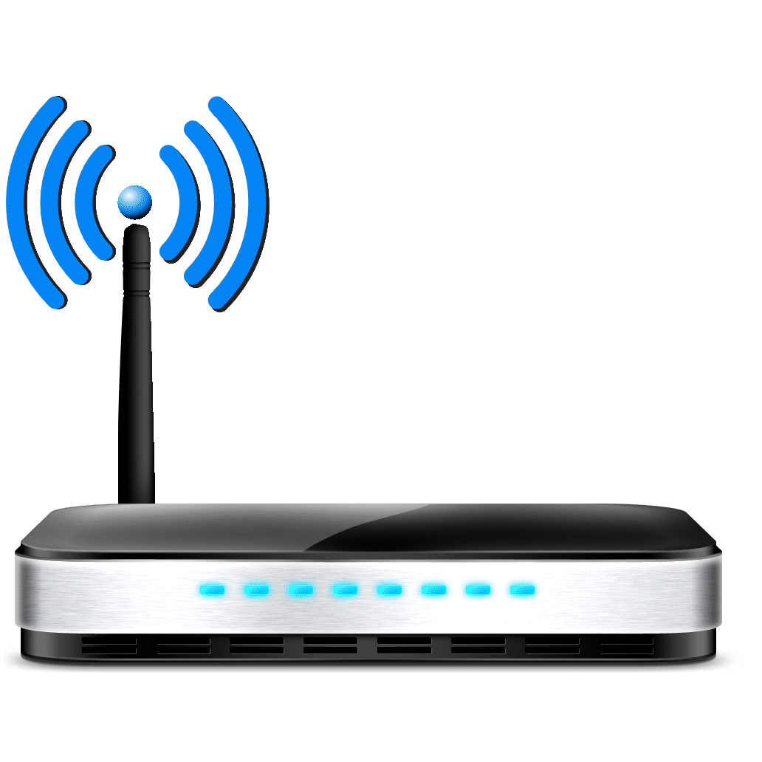
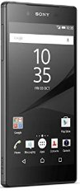

SLAM
DS
VMM
Physical Machine
Physical Machine
3. Run method
1. Prepare data
2. Offload <method> <data>
2. Offload <method> <data>
4. Result
4. Result
Client
5. Finished!
AC/AS

Slide 2
SLAM
DS
VMM
Physical Machine
Physical Machine
3. Run method
1. Prepare data
2. Offload <method> <data>
2. Offload <method> <data>
4. Result
4. Result
Client
AC/AS

Slide 3
SLAM
DS
VMM
Physical Machine
Physical Machine
3. Run method
1. Prepare data
2. Offload <method> <data>
2. Offload <method> <data>
Client
AC/AS

Slide 4
SLAM
DS
VMM
Physical Machine
Physical Machine
1. Prepare data
2. Offload <method> <data>
2. Offload <method> <data>
Client
AC/AS

Slide 5
SLAM
DS
VMM
Physical Machine
Physical Machine
1. Prepare data
Client
AC/AS

Slide 6
SLAM
DS
VMM
Physical Machine
Physical Machine
Listening for D2D devices…
Broadcasting…
Client
Received!
AC/AS

Slide 7
SLAM
DS
VMM
Physical Machine
Physical Machine
Listening for D2D devices…
Broadcasting…
Client
AC/AS

Slide 8
SLAM
DS
VMM
Physical Machine
Physical Machine
Listening for D2D devices…
Client
AC/AS

Slide 9
SLAM
DS
VMM
Physical Machine
Physical Machine
Client
AC/AS

